Slide 1
listen …

Slide 2
GES1011/GESS1009
The Evolution of a
Global City-State

Slide 3
recap …
imagining Singapore’s (globally inflected) past …

Slide 4
recap: a more recent regional human unfolding
Singapura/Temasek a nodal trading polity in the 14th century …
following in the regional legacy of Funan and Srivijaya (among many others) …

Slide 5
recap: Singapura and its successors …
decline of concentrated human activity on the island from beginning of the 15th century …
the emergence of Melaka, Singapura’s first successor (imitators?) …
the arrival of aggressive European trading concerns (Portuguese and Dutch) in the region …

Slide 6
recap: Singapura and its successors …
Singapura’s ‘second’ successor/Melaka’s successor: Johor …
the rise of other regional powers : Aceh, Jambi, etc. …
Singapura relatively depopulated ....

Slide 7
recap: Singapura and its successors …
Singapura an island under the control of the Laksamana ...
some evidence that Johor trade operated partly out of an outpost led by a Shahbandar at the Kallang river mouth ...
while there is limited archeological evidence, there is cartographical evidence ...

Slide 8
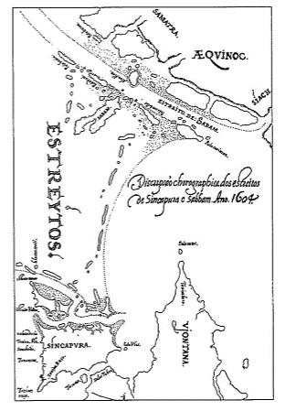
Singapura an island in a contested realm …

Slide 9
recap: Singapura and its successors …
the island offered to a British country trader in the early 18th century ...
a relative marginalisation and depopulation ...
under control of Temenggong …
presence of Chinese gambier planters (invitees of the Temenggong) …

Slide 10
Question and Response

Slide 11
our task today …
observing the colonial remaking of a nodal trading point in Singapore in the early years of British presence (control and confinement) …
with some insights from an indigenous observer ...

Slide 12
colonialism/imperialism…
rival European polities had been using maritime silk roads with ambitions to control/dominate the spice trade since the late 14th/early 15th century ...
willing to wage war and gain control of key nodal trading centres …
by the end of the 18th century, the Dutch were in control of Batavia and Melaka, pushing most trade activity south towards the Sunda Straits and Batavia ...

Slide 13
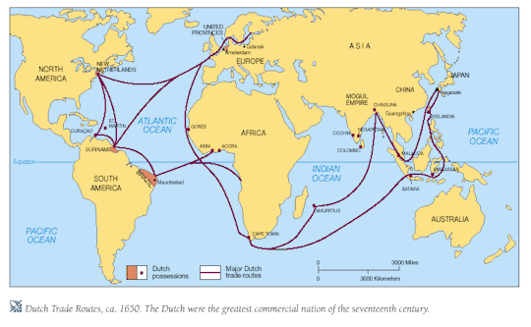
VOC/Dutch exploration and colonisation …

Slide 14
colonialism/imperialism…
but these instances of imperial/colonial activity we have seen thus far ...
are part of a wider story of colonial/imperial ambitions that have been taking place worldwide ...
and while largely European, it was not wholly so ( Ottoman*not transoceanic maritime explorers/discoverers; late Tongan ‘imperialism’ in the Pacific) ...
for perspective, let’s take a brief look at these wider colonial/imperial unfoldings ...

Slide 15
1490s

Slide 16
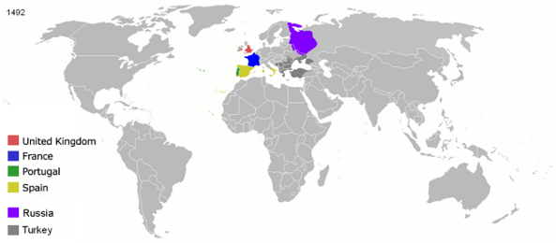
colonialism/imperialism…

Slide 17
1500s

Slide 18
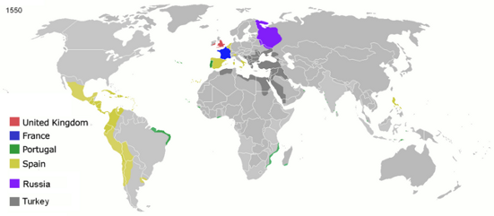
colonialism/imperialism…

Slide 19
1600s

Slide 20
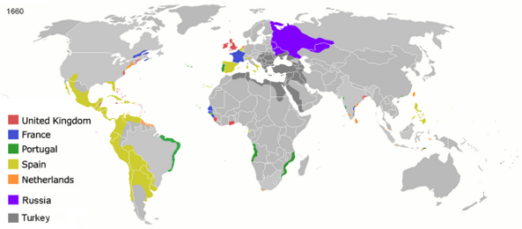
colonialism/imperialism…

Slide 21
1700s

Slide 22
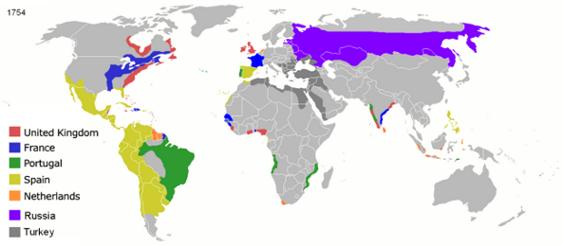
colonialism/imperialism…

Slide 23
1800

Slide 24
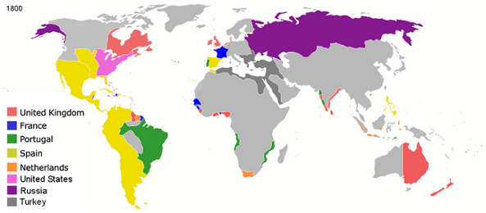
colonialism/imperialism…

Slide 25
Question and Response

Slide 26
another presence in the region …
by the late 1700s, in the straits ...
the Portuguese had been virtually eclipsed ....
by the Dutch who were dominant, and while in control of Melaka ...
their power base was further south in Batavia ...

Slide 27
another presence in the region …
the Dutch were latterly joined in the region by the English EIC (English East India Company)/British ...
private British traders (country traders) had been active in the region since the early 1600s ...
and the EEIC had existed since 1600 ...

Slide 28
another presence in the region …
effective EEIC presence in the region not until the late 1700s …
EEIC looking for a foothold in the straits to vie for control of trade (spice and others) …
Penang founded in 1786 (formalized in 1791)

Slide 29
another presence in the region …
Penang too far north so EEIC still looking for a point of control toward southern end of straits …
1795, EEIC becomes caretaker of some of VOC’s possessions (Dutch East India Company) in straits for fear that France would move to wield its influence regionally, particularly in the straits off Melaka ...
(notice global inflection of happenings in the straits) …

Slide 30
EEIC in Singapura ...
EEIC, through Raffles, gained a foothold in Singapura/Singapore in 1819 …
Raffles had found out about Singapura from the Sulalat …
found it and negotiated a treaty for a ‘factory space’ (loji) with its Malay overseer/ruler in 1819 …

Slide 31
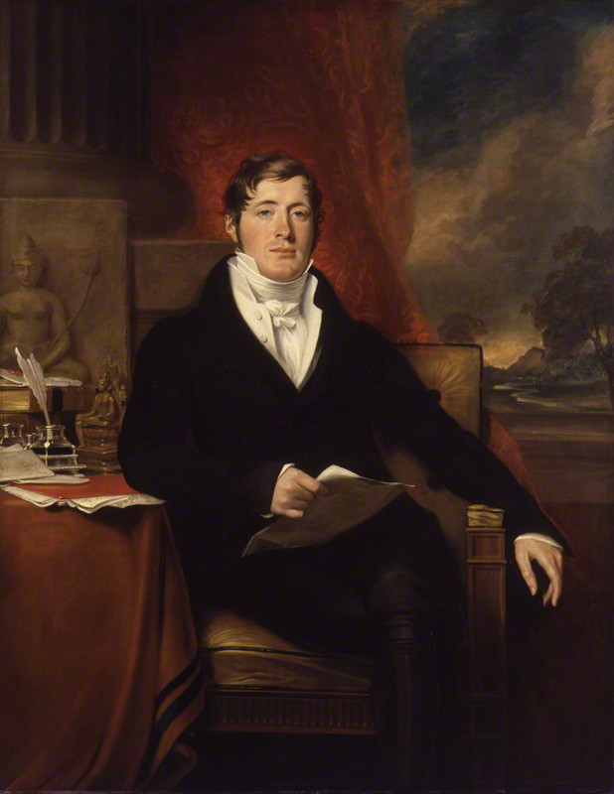
Sir Thomas Stamford Bingley Raffles
1817
Oil on canvas
139.7cm x 109.2cm
Copyright of National Portrait Gallery, London

Slide 32
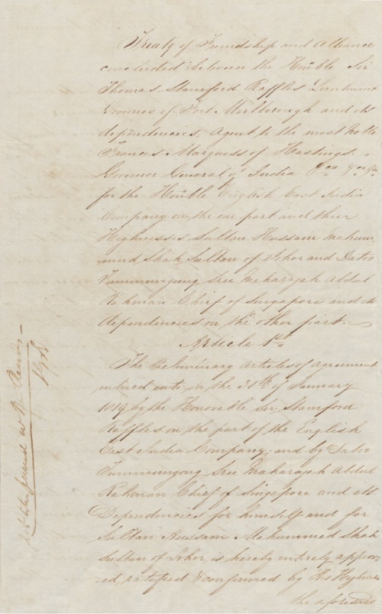
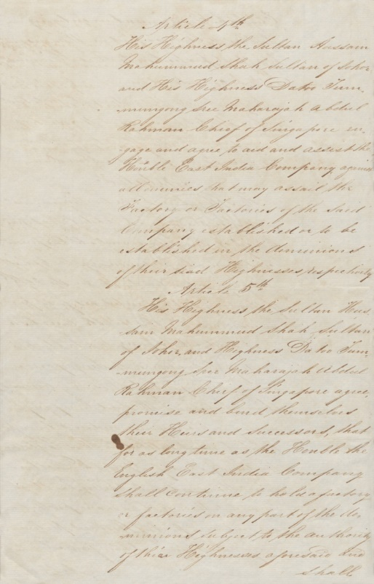
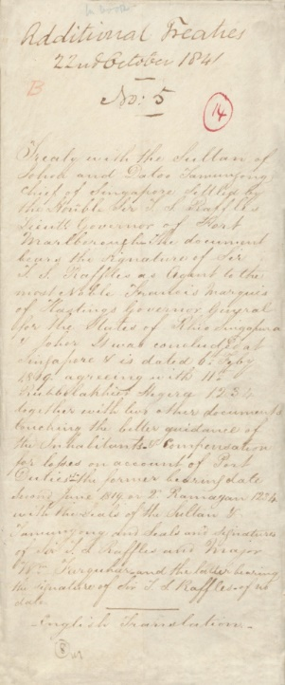
Record of the 1819 Treaty of Friendship and Alliance
6 February 1819 Copy made in 1841
Collection of the National Archives of Singapore
On view at Law of the Land: Highlights of Singapore’s Constitutional Documents, UOB Southeast Asia Gallery, Level 3, Supreme Court Wing

Slide 33
EEIC in Singapura ...
tensions between VOC-EEIC further aggravated with EEIC in Singapore …
EEIC and VOC deem it more prudent to avoid trade motivated war …
Anglo-Dutch Treaty signed in 1824 …
agree on clear delineation of spheres of influence in and around Straits of Melaka …

Slide 34
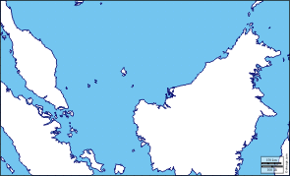

Slide 35
EEIC in Singapura Singapore* ...
EEIC formalised treaty for control of entire island of Singapore with Malay overseers in 1824 …
1824 Treaty of Friendship and Alliance

Slide 36
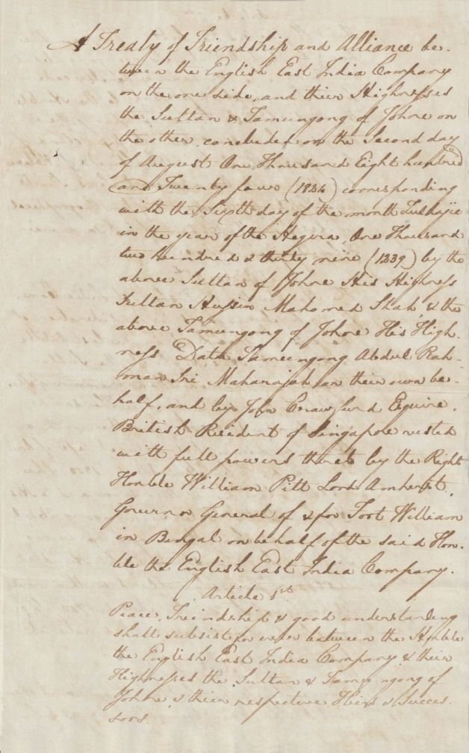
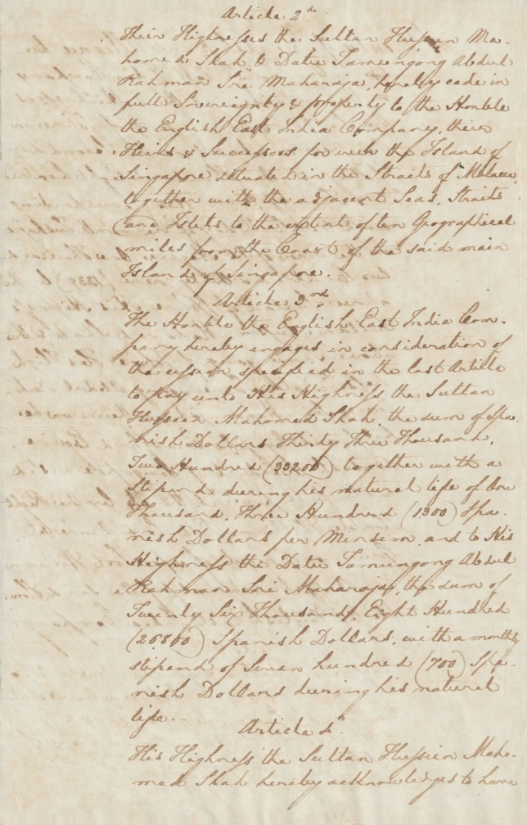
Record of the 1824 Treaty of Friendship and Alliance
2 August 1824 Copy made in 1841
Collection of the National Archives of Singapore
On view at Law of the Land: Highlights of Singapore’s Constitutional Documents, UOB Southeast Asia Gallery, Level 3, Supreme Court Wing

Slide 37
EEIC in Singapura Singapore ...
Raffles wanted a global emporium …
and the Singapore River ‘s immediate environs …
was reimagined and engineered to become a …
trading point/veritable walk-in ‘shop’/display of wares …

Slide 38
EEIC in Singapura Singapore ...
wharf/quay: [load/unload goods (and people) ]…
godown (store goods) ...
‘factory’ (recombine/repackage goods) ...
refuel, resupply and repair vessels ...

Slide 39
EEIC in Singapura Singapore ...
within two decades …
infrastructure supporting a maritime emporium in place ...
south bank partially reclaimed* and embanked ...
godowns built ...
trading concerns found along banks of river ...
regulatory (government) offices in place on north bank ...

Slide 40
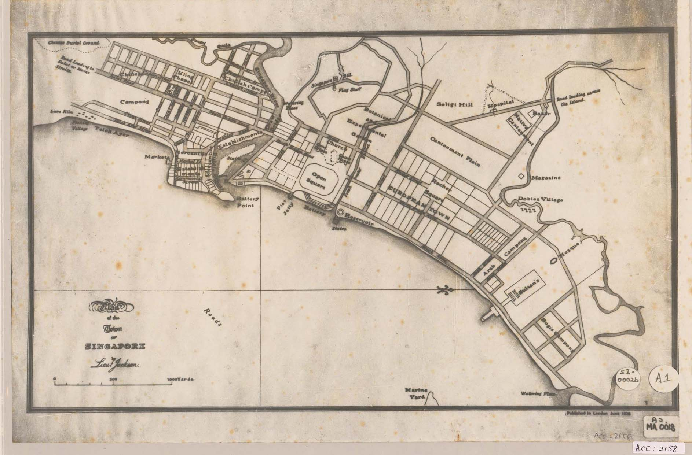
EEIC in Singapura Singapore ...

Slide 41
EEIC in Singapura Singapore ...
goods traded in Singapore from around the entire globe …
attracted by an accentuated form of free trade ...
free trade usually meant freedom from import/export duties ...
but in EEIC’s Singapore ...
it extended to port charges (akin to free parking) ...
made the prices of goods very competitive and globally attractive ...

Slide 42
EEIC in Singapura Singapore ...
people came flooding in …
looking for work ...
business opportunities ...

Slide 43
EEIC in Singapura Singapore ...
in 1824, Singapore had about 10,000 residents:
Malays 4,500
Chinese 3,317
the rest: Bugis, Indians and less than a hundred Europeans …

Slide 44
EEIC in Singapura Singapore ...
18,000 in 1830 ...
52,000 in 1845 ...
by 1845, the Chinese had outnumbered the Malays by a ratio of 3:1 …
the rest: Bugis, Indians, about 300 Europeans alongside a smattering of Arabs and even fewer Jews ...

Slide 45
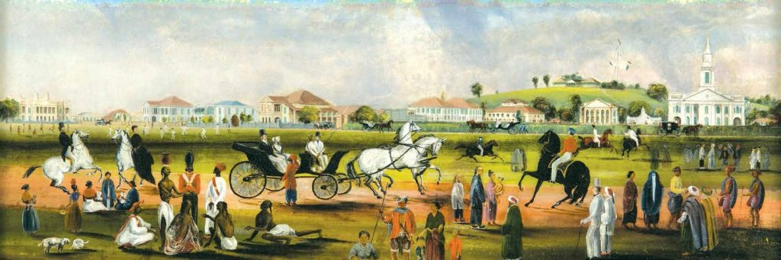
EEIC in Singapura Singapore ...

Slide 46
EEIC in Singapura Singapore ...
97,000 in 1881
Chinese: 54,000
Malays: 26, 000
Europeans: 2,000
Eurasians: 2,200

Slide 47
Question and Response

Slide 48
an early observer of EEIC’s Singapore ...
besides goods and people ...
new technologies made their way to Singapore’s shores ...
and we have an indigenous observer who witnessed (and participated) in the EEIC’s makeover of this historical seat of regional power ...

Slide 49
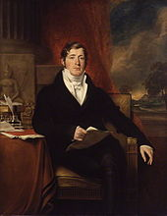
an early observer of EEIC’s Singapore ...

Slide 50
an early observer of EEIC’s Singapore ...
In physiognomy he was Tamilian of South Hindostan. He was tall, slightly bent forward, spare, energetic, bronze in complexion, oval faced, high nosed, and one eye squinted a little outwards. He dressed in the usual style of Malacca Klings or Tamils, having an Acheen saluar (trowsers), checked sarong (kilt), printed baju (coat), a square skull cap, and sandals. He had the vigour and pride of the Arab, the perseverance and subtlety of the Hindoo,—in language and national sympathy only was he Malay. But the translations will better illustrate the man, modified undoubtedly as his character was by contact with superior European and American intellects, such as ... Milne, and North.

Slide 51
an early observer of EEIC’s Singapore ...
In physiognomy he was Tamilian of South Hindostan. He was tall, slightly bent forward, spare, energetic, bronze in complexion, oval faced, high nosed, and one eye squinted a little outwards. He dressed in the usual style of Malacca Klings or Tamils, having an Acheen saluar (trowsers), checked sarong (kilt), printed baju (coat), a square skull cap, and sandals. He had the vigour and pride of the Arab, the perseverance and subtlety of the Hindoo,—in language and national sympathy only was he Malay. But the translations will better illustrate the man, modified undoubtedly as his character was by contact with superior European and American intellects, such as ... Milne, and North.

Slide 52
an early observer of EEIC’s Singapore ...
Abdullah bin Abdul Kadir (1796-c.1854) ...
professor of the Islamic faith …
speaker and writer of Malay and Tamil …
vocation as scribe, translator, language teacher, cultural intermediary to incoming Europeans …

Slide 53
an early observer of EEIC’s Singapore ...
Abdullah, given his position of contact with Europeans ...
had an opportunity to gain a glimpse of ...
a steamship ...
a symbol of even further imperial dominance to come ...

Slide 54
an early observer of EEIC’s Singapore ...
sailing vessels were well known to Abdullah ...
who hailed from Melaka ...
and whose forebears had migrated to Melaka from south Asia ...
whose forebears had been on European deputations across the sea ...
Abdullah, too, had similar experiences ...

Slide 55
an early observer of EEIC’s Singapore ...
however, Abdullah, on seeing the Sesostris ...
and given a peek into its mechanism ...
was simply awed by this invention (struck speechless, amazed, etc.) ...

Slide 56
an early observer of EEIC’s Singapore ...
"Therefore I believed that they really did exist although I was trusting only a rumour, not yet having seen what they looked like. In spite of this I used to tell all of my friends about the skill and ingenuity of the white men, the things I had seen and had heard intelligent Englishmen discuss until I came to the subject of steampships. Then my friends became angry and argued with me, calling me a liar and saying 'You always magnify the prowess of the English and tell us the most impossible things', and some of them ridiculed me for telling them that steamships really existed"

Slide 57
an early observer of EEIC’s Singapore ...
and given the provenance of this technological innovation ...
viewed alongside British remaking of Singapore ...
levelling hills and creating banks, wharfage, the sheer volume and variety of goods and people flooding into Singapore ...

Slide 58
an early observer of EEIC’s Singapore ...
it provided a sheen of grandeur on EEIC activity in and around Singapore ...
placing yourself in Abdullah’s position, would you have been impressed?
how would you have made sense of these changes?
and how would we encapsulate this relationship between the new ruler and the ruled and the realm it ruled ...

Slide 59
Question and Response

Slide 60
colonialism/imperialism…
before we continue the story into the mid/late 1800s ...
let’s think about the terms used to describe these growing relationships which includes territories like land of cheap massages and peranakan food Melaka and Singapura Singapore ...
colonialism ...
imperialism ...

Slide 61
colonialism/imperialism…
parts of the last and this lecture ...
narrate how Europeans came into the region ...
and discussed the situation/status of Singapura a geographically strategic space ...
and since 1824 ...
this space has been called Singapore and under European control ...

Slide 62
colonialism/imperialism…
an elephant in the room ...
is a larger question:
how do you use/understand the word/notion colonial and imperial?

Slide 63
colonialism/imperialism…
watch …
videos depicts rather typical but problematic approaches to imperialism …
problematic mainly because of a lack of historicisation ...
yes, imperialism involved control and domination but there was more to it …

Slide 64
colonialism/imperialism…
control and domination took different forms in different contexts (time and space) ...
and in the next two lectures ...
we take a more in depth look at colonialism/imperialism ...

Slide 65
Question and Response

Slide 66
27 September 2022: Midterm
Open Book Test: (20%)
18:05-19:45pm
in-class exam …
excused absence only for:
bereavement in the immediate family
certified illness

Slide 67
27 September 2022: Midterm
some quasi-MCQs ... questions with options provided but additionally, a qualitative explanation required for option chosen …
some short-response questions …
some sample questions have been placed in a workbin …

Slide 68
(the notion of objectivity, parsed as the view from nowhere, does not add any value in efforts to understand and explain the creation of human knowledge)

Slide 69
27 September 2022: Midterm
emphasis is on thinking/interpretation
‘acute’ observation skills …
have never tested content …

Slide 70
Question and Response

